Slide 1
C17870 Game design Project Presentation
By Thomas Simmons
K1906250

Slide 2
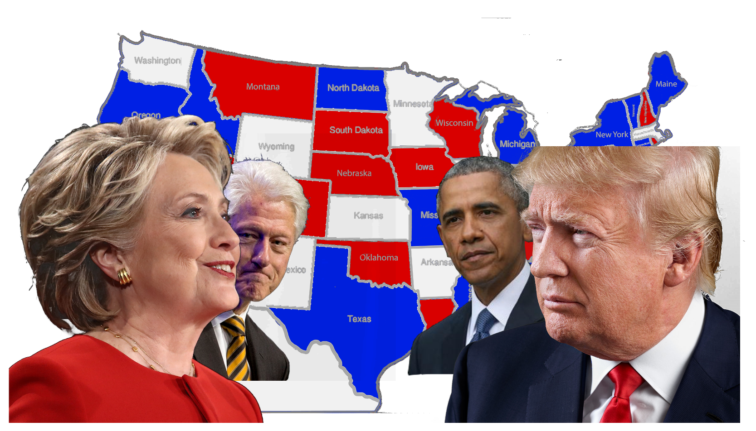
Land of the free 2021
Very recognisable characters
All the Playable characters in Logo
Not been a Trump game of this type
For all types of gamers

Slide 3
Game Story
Based in America in 2021
Political Civil War
Country divided into three main factions
Three different stories the player can chose from
Different winning conditions for each character
Varity of political opinions

Slide 4
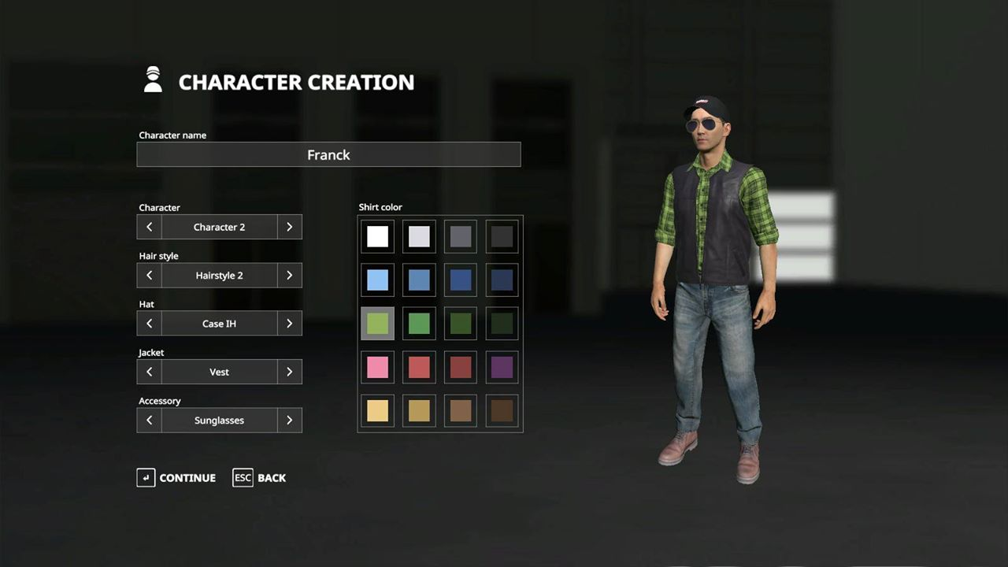
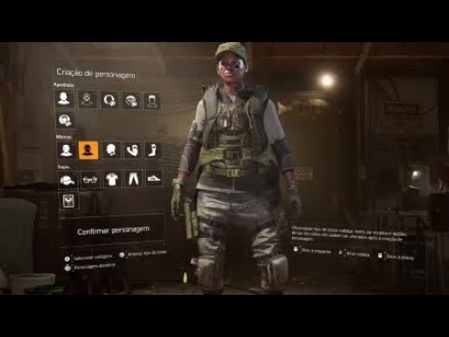
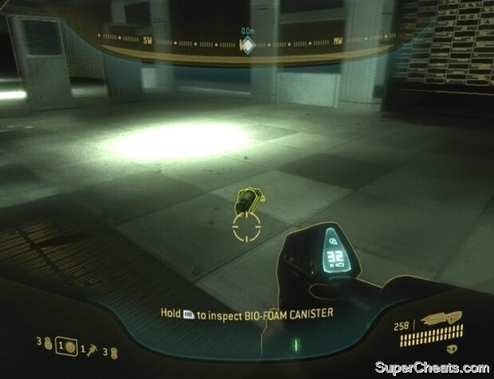
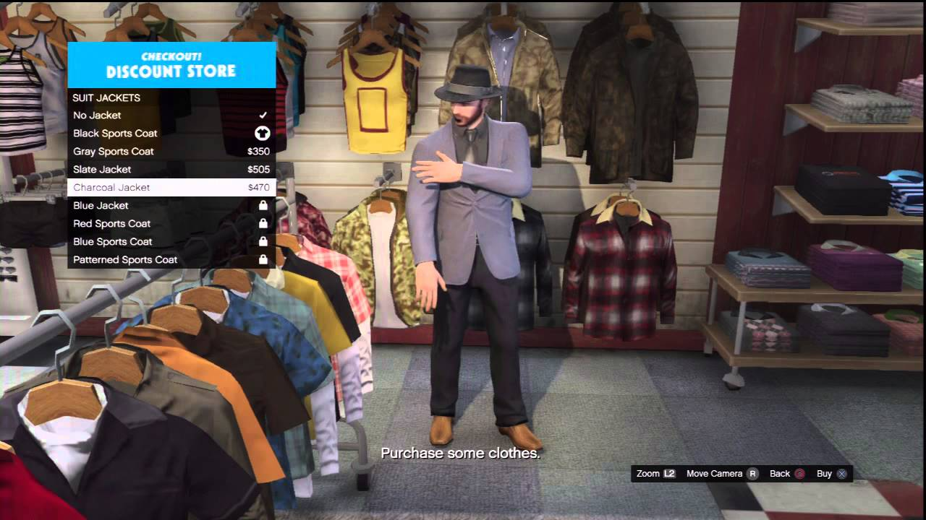
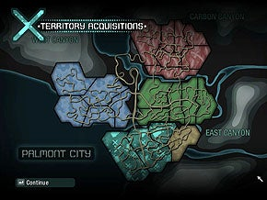
What I got inspiration from
Tom Clancy’s Division and Ghost Recon
GTA V customisation options
Farming simulator 2019 customisation UI
Halo 3 ODST collectable system
NFS Carbon territory system
Recent events in America

Slide 5
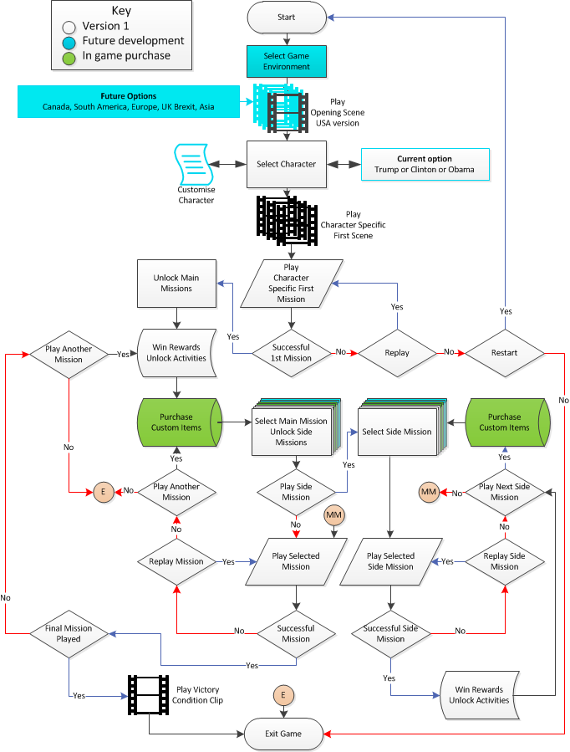
Game Progression Chart
Opening backstory cut scene
Character selection
First mission
Main, side and activities
Victory conditions
Opportunities for monetization

Slide 6





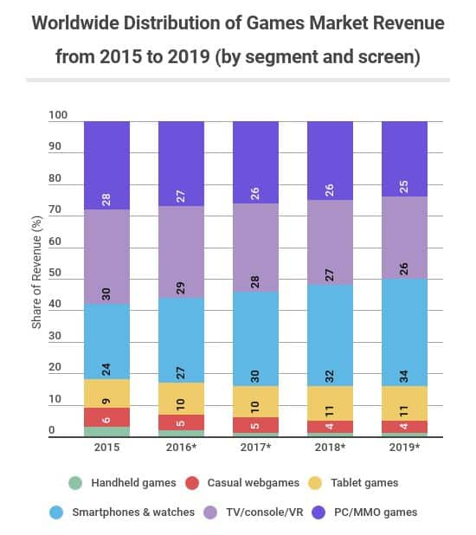
Target Audience/Profile
Target players: Male & Female aged 16+
PEGI/ ESRB rating: 16 due to content
Players who like Tactical, Exploration & Social Games
Intended game systems: Android, Apple Mobile users and Console
Interested in worldwide politics
Watch a lot of movies and TV, access social media daily.
Van Korlaar, C (2012)
Newzoo (2019)

Slide 7

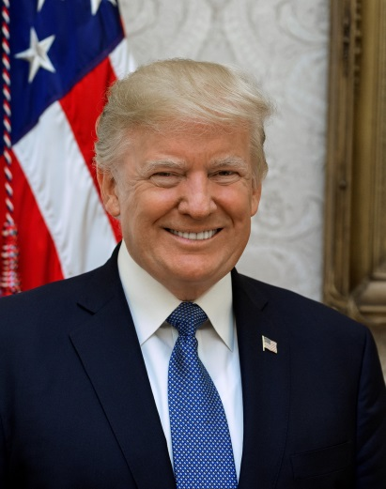
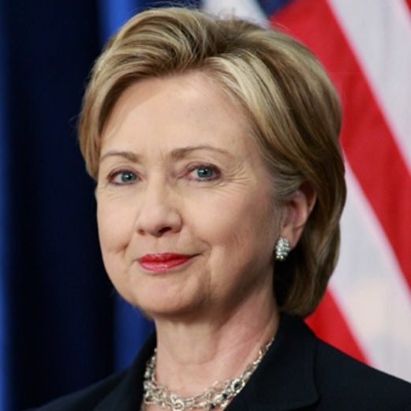
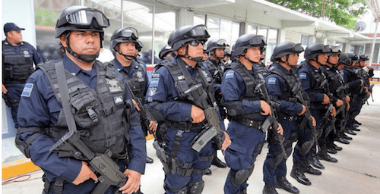
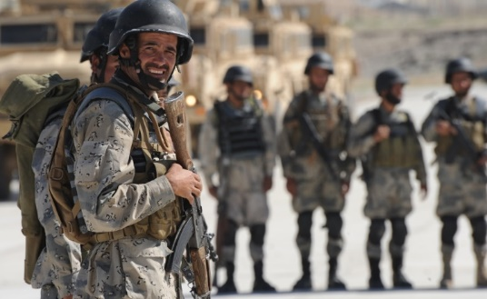
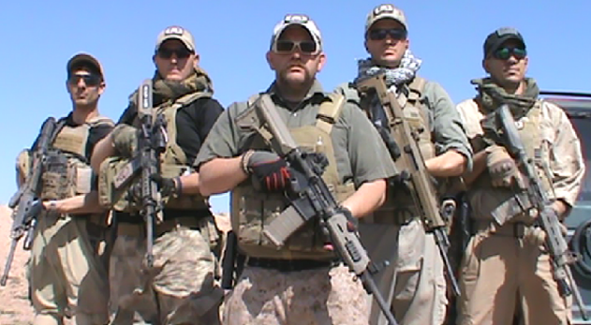
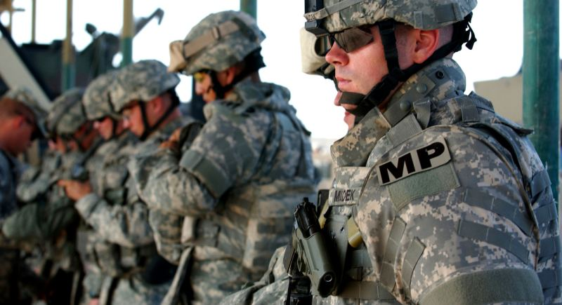
Characters
Player characters and relatives
State & city militia
Secret Service
Mercenaries
National Guard & police
Mexican Police & people
Political influencers

Slide 8

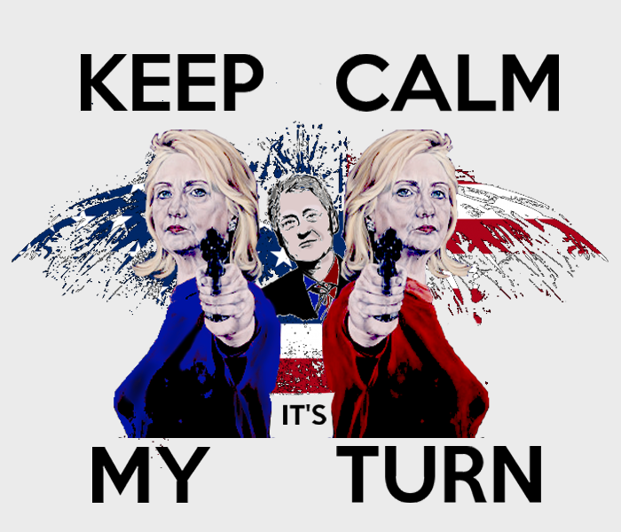
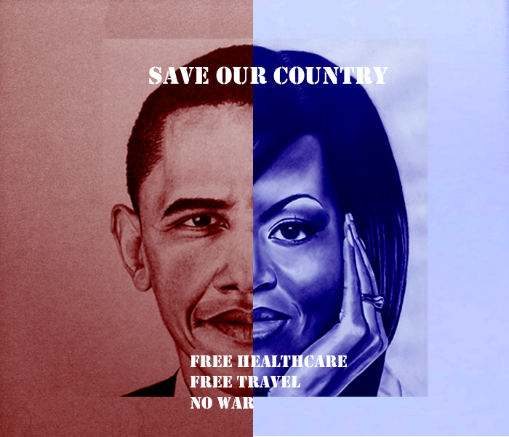
Game Factions
Donald Trump
Hillary Clinton
Barack Obama

Slide 9
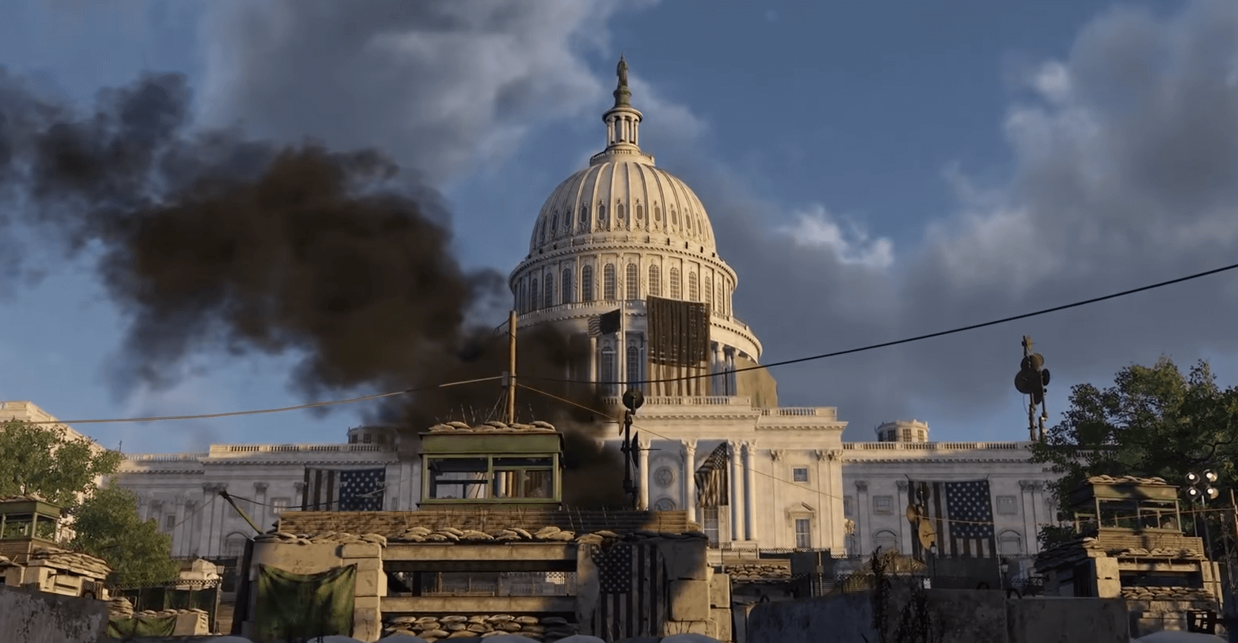
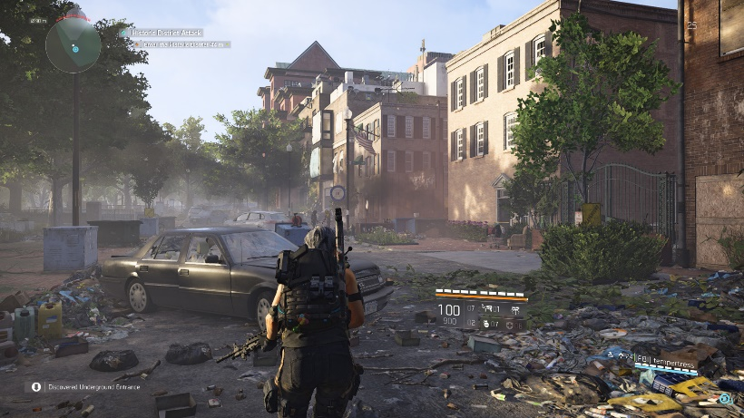
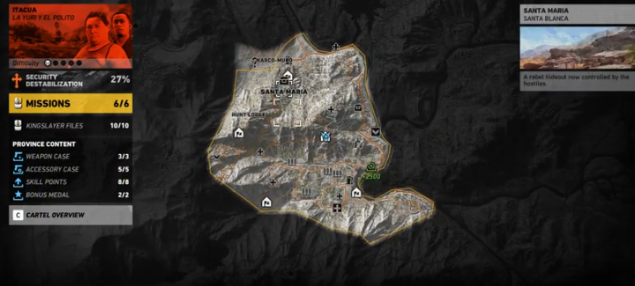
Gameplay & Environment
Third Person Shooter Role Playing Game
Moving across the map gathering influence
Earn rewards (game currency, influence, weapons)
In the levels the player is introduced to new abilities
Encounters (enemies and allies)
Collectables

Slide 10
Game Mechanics
Selection of different movements and actions
Character development (ranking up, storytelling)
A menu screen
Players interact with objects
Area control/ influence (states and cities)
Discovery (weapons and armour)
Encounters (traps/ human and natural hazards Asset deployments)
Dialog from characters (PC’s and non PC’s)
Trading goods (weapons, resources)

Slide 11
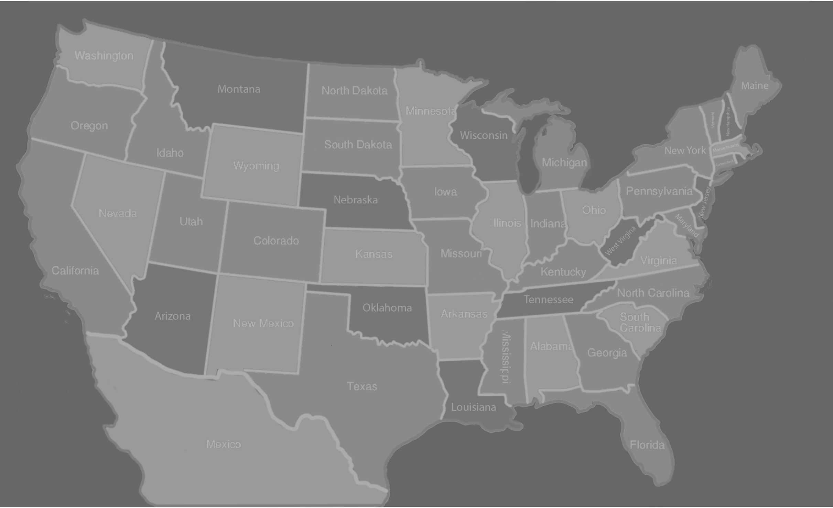
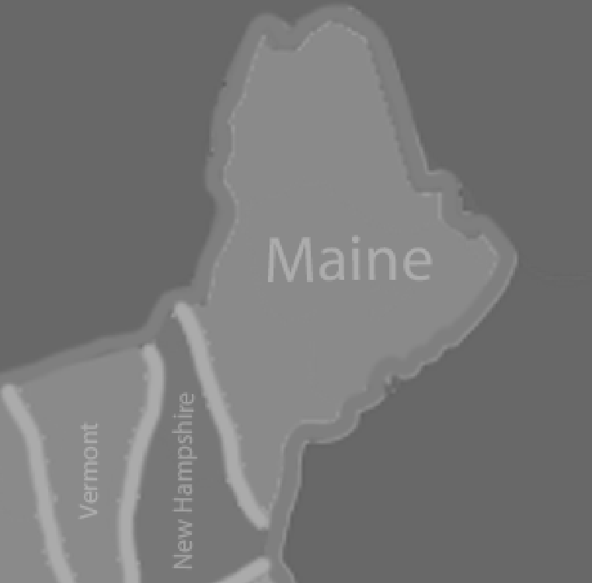
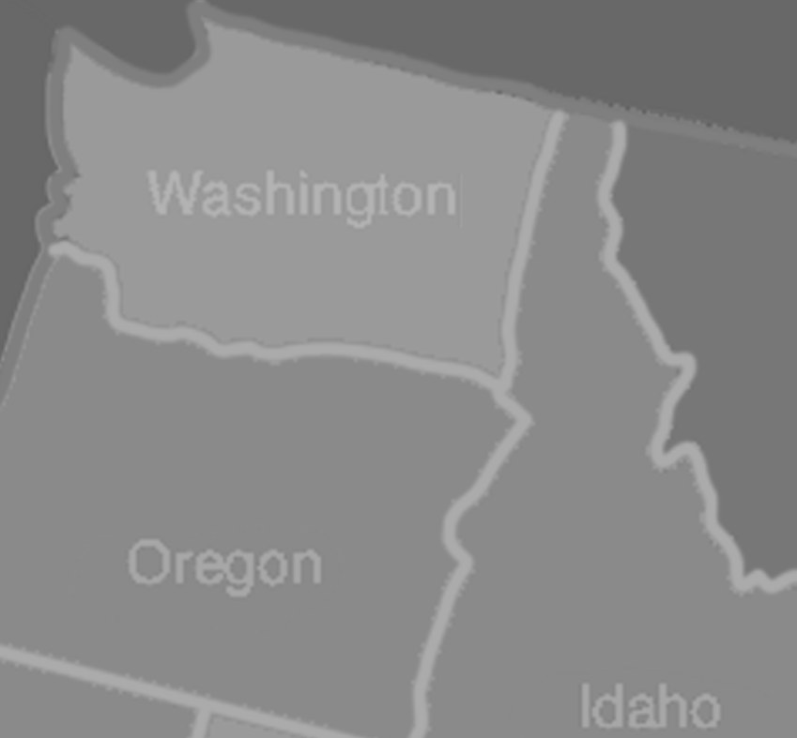
Game Map
Game world is America and Mexico
Smaller states have less missions
Bigger states are split in sections
Character starting points
Mexico cant be captured
Influence system

Slide 12


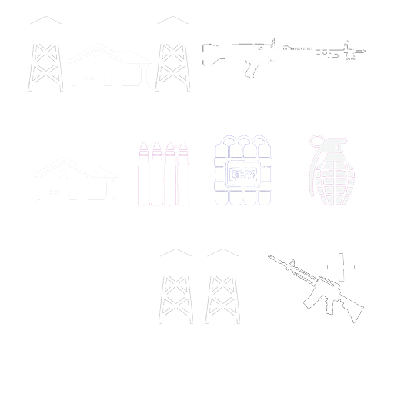

Game Icons
Main and side missions are stars
Discovery, interception, looting & propaganda
Character mission variance
Character specific missions and activities
Areas of interest
Rewards

Slide 13

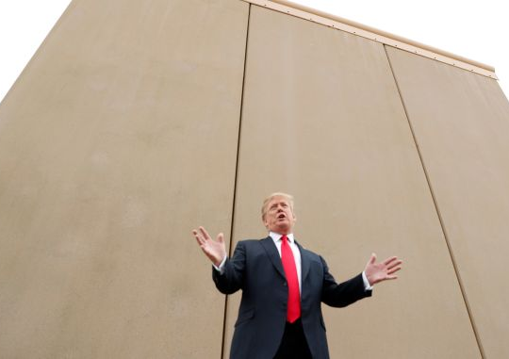


Game Locations
Iconic buildings/ structures represented
Difficulty level and rewards
Find intel of real world articles/ news stories
Extra boosts and buffs

Slide 14
Game Audio & speech
Character speech varies on the situation at hand
Character exclusive
Mission soundtracks
Menu soundtracks
Collectable guiding
Environmental soundtracks

Slide 15
Game Experience
Players will feel sadness towards America and the state its in
Destruction, no hope, frustration
Signs of overgrown vegetation
Fun/ laugh towards characters being used
Player choice
Hope, revenge or escape depending on character selection

Slide 16
Game Assets
Use sketchfab to showcase models

Slide 17
In Game Purchases & DLC
Purchases of different armours/ bullet proof vests
Outfits for characters
Purchased allies such as mercenaries/ secret servicemen
Loyalists/ Trump enthusiasts
Seasonal Customisations
Countrywide issues such as Brexit

Slide 18
Future Development
Explain what you’re going to do for the deadline and afterwards

Slide 19
References
Van Korlaar, C. (2012). Know your target audience: 10 questions to ask. [online] Topnonprofits.com. Available at: https://topnonprofits.com/know-your-target-audience-questions/ [Accessed 13 Jan. 2020].
Newzoo. (2019). 2018 Video Game Industry Statistics, Trends & Data - The Ultimate List. [online] Available at: https://www.wepc.com/news/video-game-statistics/ [Accessed 13 Jan. 2020].

Slide 20
Questions?

